Slide 1




DIGITAL LITERACY
SKILLS
BASIC USERS

Slide 2
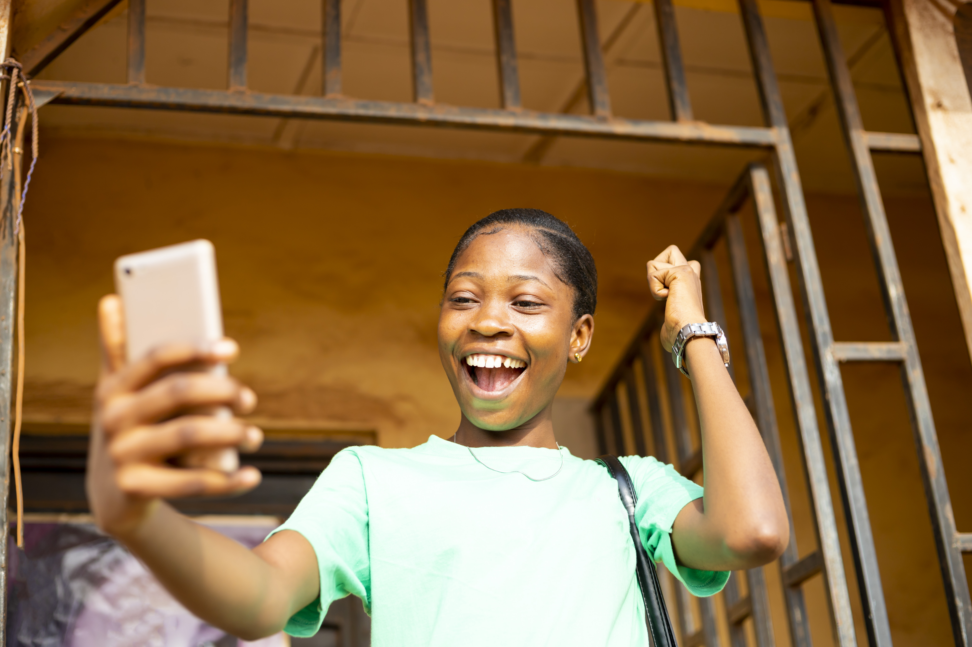
Module 4
Content

Slide 3

1
Unit 3: Copyright and licenses

Slide 4
Main concepts: IT, ICT, and Internet
Copyright ownership gives the owner exclusive rights to use the work, with some exceptions.
When a person creates an original work, fixed in a physical form (electronic or hardcopy), they automatically own copyright to the work, for example:
audiovisual works, such as TV programmes, films and online videos
sound recordings and musical compositions
written works, such as lectures, articles, books and musical compositions
visual works, such as paintings, posters and advertisements
video games and computer software
dramatic works, such as plays and musicals.

Slide 5
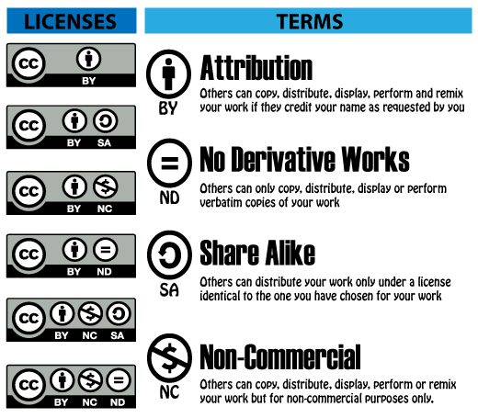
Using a copyright-protected work without infringing
It’s possible to use a copyright-protected work without breaking the owner’s copyright.
Some content owners make their work available for reuse with some limitations under a Creative Commons license.
There are six Creative Commons (CC) licenses.

Slide 6
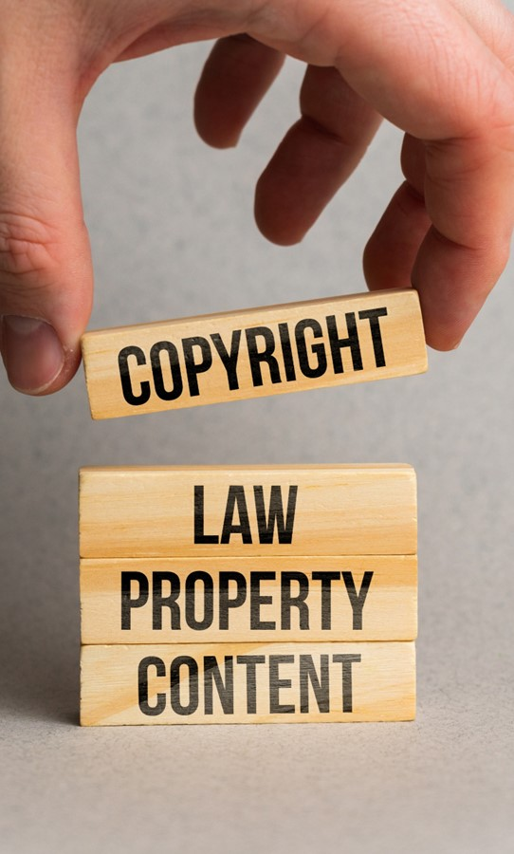
Copyright law
Copyright law exists in all countries.
Work created in a country is subject to the copyright laws of that country and the copyright laws of the country in which it may be used.

Slide 7
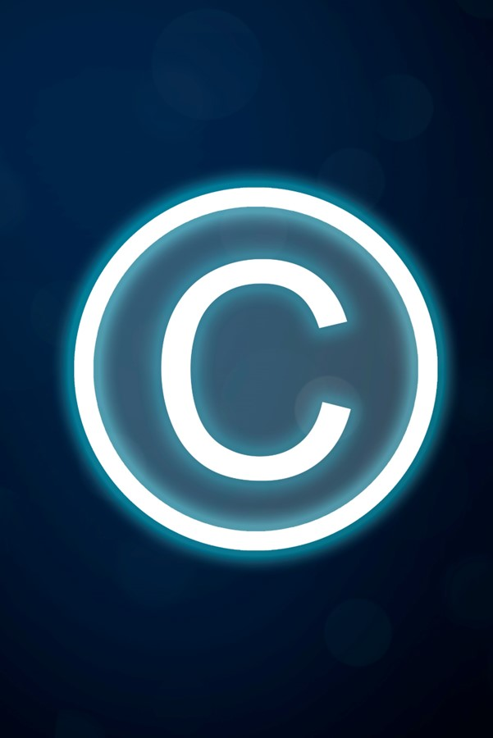
Copyright law and the internet
The internet makes it very easy to copy other people’s work directly into your own document.
It’s illegal if you do not acknowledge the person who created it.
The creator is the owner of that content, so copying it and letting people think it is your own work is plagiarism, which is a form of theft.

Slide 8

Copyright law and the internet
This applies to all types of content, such as written content, images, videos, and audio recordings.
You can reuse any content you if:
you don’t sell it for profit
if you write a reference to the owner below it or next to it.

Slide 9

Online plagiarism checkers
Free plagiarism checker apps allow people to upload suspicious content for checking.
The checker compares the suspicious content with content in hundreds of similar or related documents.
It is very difficult to get past these checkers as they check and compare word for word and line by line.

Slide 10
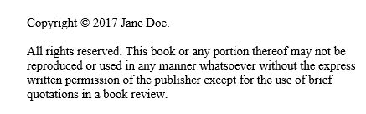
Skills to practise
Check copyright
Look at the picture below.
Notice the © symbol and the date?
Now open a school textbook to the second page of the book. Do you notice the same symbol?
Continue >

Slide 11
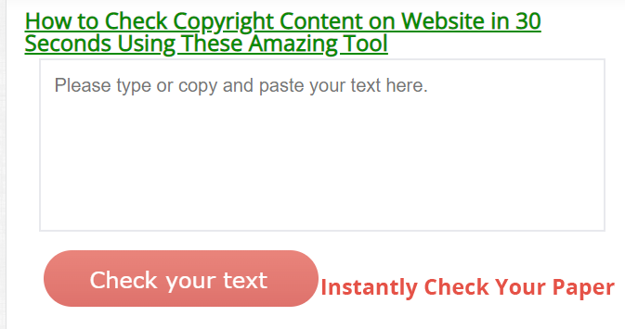
Skills to practise
It is very easy to check if content on the internet is copyrighted.
Open this website: https://www.copyrightchecker.net/how-to-check-copyright-content-on-website-in-30-seconds/
Copy and paste the text you want to check and click on ‘check your text’.

Slide 12
All back covers should include
contact information of the section
producing the work.
© United Nations Children’s Fund (UNICEF) [month and year of publication]

